Slide 1

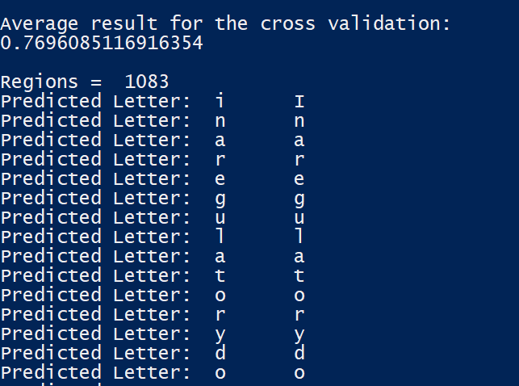
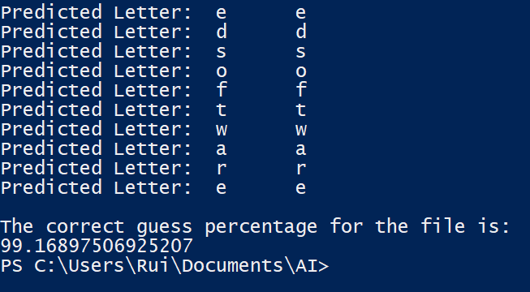
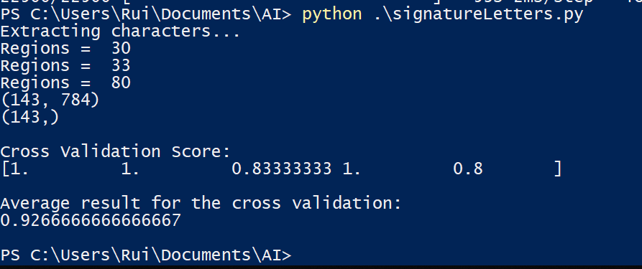
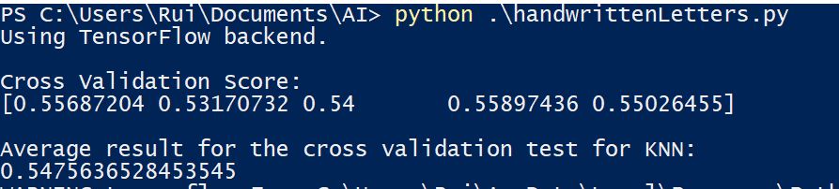
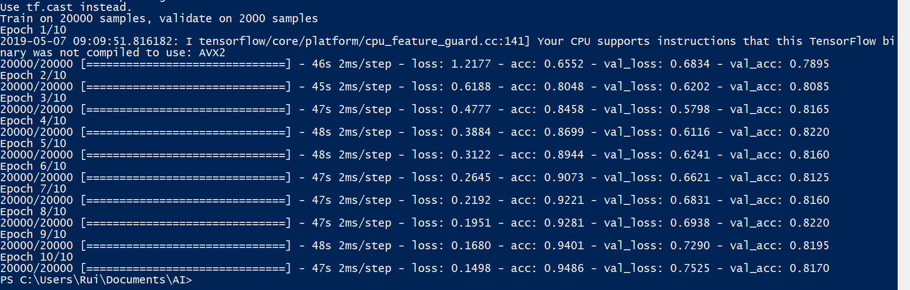
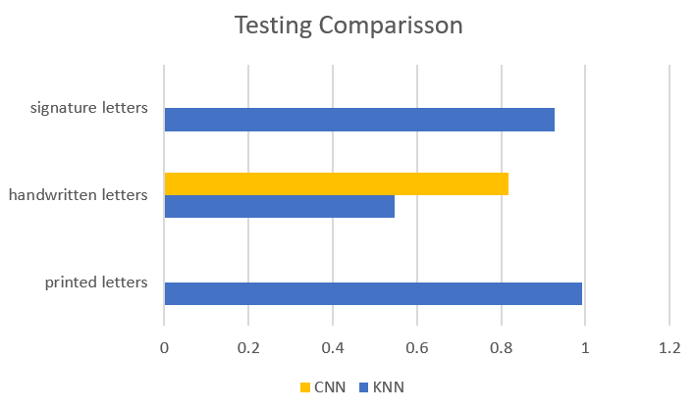
Character and Signature Recognition
Project Objectives
Develop an engine that extracts letters and words from an image of a printed page and outputs the printed text back. Develop an engine that extracts letters and words from an image of handwritten notes Build a system that accepts a signature and returns the name of the owner of the signature Research Question – Describe how you would build an engine that takes handwritten texts as an input and is able to understand who is the author is. Test the percentage of correctly identified letters in all engines.
References
Geron, A. (2017). Hands-On Machine Learning with Scikit-Learn and TensorFlow. O'Reilly.
Implementation
printedLetters.py – This printed letters file will use the extract letters file provided to select regions and will sort them into a class. Every letter’s pixel data is passed to a numpy array x. Array x and a label y are zipped together and shuffled to train them against their right class. This input data will be trained by the KNN classifier shown in the labs with a 90:10 ratio of training and testing dataset. This is done to prevent underfitting and overfitting. Then the engine predicts the results and printing out this prediction. To test the results, we use cross validation also used in the labs. handwrittenLetters.py – The input data is the EMNIST dataset available to import so we don’t have to use the extract file available. Then, the same process from printed letters is used train the dataset using the KNN classifier, again being careful not to underfit or overfit the training data. In this file, I also included a CNN classifier to train and test the classifier as the input data is large enough for CNN to provide a good prediction. (Using 22500 for training and 25000 for testing) signatureLetters.py – The signatures here are extracted in order from an input file as that file contains only 1 person’s signature, so there is no need to sort them in order. Then this dataset is randomly shuffled and partitioned to be training and testing data in 90% training and 10% test. This dataset is trained using KNN and tested using cross validation.
(…)
Results and Testing
Results for printedLetters.py - As seen in figure 1, printed letters extracts characters and determines the number of regions. Then the regions are placed in a numpty array and the total shape of that array is calculated. Once in these arrays it will use KNN to classify and train the dataset. Cross validation is used and the 5 sets of results are returned and averaged. After, the engine is run on a test file and it prints out the prediction of the contents of the text file along the true letter that the letters should be. It also runs does cross validation to rerun a percentage of correct predictions. For testing, the first cross validation is usually around 80% whereas, the second test cross validation is anywhere from 90% to 99%. An example run result can be seen in figure 1. Results for handwrittenLetters.py – As seen in figure 2, handwritten letters imports EMNIST and because it already is shuffled, it can train the KKN classifier immediately after reshaping the arrays. Then, cross validation is done on test letters to check the score of the result for KNN. After KNN is done, CNN is trained. It then runs the classifier on test data and gets 10 percentage values for each epoch. For testing, KNN cross validation is around 55%, but CNN’s percentage is around 80-85%. Results for signatureLetters.py – As seen in figure 3, signature letters imports the data set from 3 .png files which contain the signatures of two different people, and appends them to numpy arrays. The first 2 regions extracted are for one person and the third region is another person. After obtaining the data set the KNN classifier is trained with the a training dataset and tested with cross validation on a test dataset. For testing, the cross validation on signatures ranges from 90% to 100% and an example run result can be seen in figure 3.
Figure 1 – Run of printedLetters.py
Figure 3 – Run of signatureLetters.py
(…)
Figure 2 – Run of handwrittenLetters.py
Writer Identification Research Task
To build an engine that received as input user handwritten documents and can successfully identify that document’s author, you would have to do list of things: a.) Firstly, I would identify which classifier would be ideal. In an engine like this, there will be hundreds of thousands of documents to be trained. Given the drastic percentage increase we saw on handwritten letters with using CNN instead of KNN, I would suggest implementing CNN classifier on this engine as there would be enough documents for CNN to be properly trained and therefore, the percentage would increase. b.) Secondly, I would decide whether I would start the training with characters or word recognition. This would be a mixture of the code written for handwritten letters and signature letters as you would be getting the region of the letters but also identifying who their author was. c.) Lastly, as the task states that the engine should detect the author of these writings, we should go into even more detail by training the system to know the style of writing of a given author. This would be a hard thing to quantify as there as a style of writing has infinite variables associated with it, but a simple for of this would be for the system to recognise commonly used words or sayings that certain authors write more than others.
Figure 4 – Clustered bar chart comparing the correct percentages on test data
Review
Printed Letters – The testing data’s percentage was much greater than the testing data. One hypothesis to why this is happening has to do with the training data. The files used re written in many different fonts, which decreases the training data for a given font. This means that the engine will struggle to get as high prediction as for the testing. Handwritten Letters – Results show how much harder it is for a system to learn handwriting. Because it is more varied, the engine has to go through much more training data than with printed letters for the same results. Also, it was clear how much better CNN was in comparison with KNN with larger datasets. Signature Letters – Results here demonstrate how easy it is to produce a classifier that identifies an owner based on a signature. Because a signature is relatively unique, it is easy to train the engine as they are a clear yes or no. Because of this, my engine was averaging 90-100% correct predictions.
Improvements
One way to improve all engines is to provide more training datasets. The longer an engine can run those datasets, the more variances it has seen so it can more easily correctly predict. Specifically for signatures, I would add more people. I believe that because currently there are only 2 different signatures being trained, it is easier to predict correctly because there aren’t many wrong options to pick. Lets say there were 100 different people’s signatures, I believe the accuracy would go down as it can predict a similar signature with someone else's signature.
Conclusion
To conclude I think that this was a great way of being introduced to AI. I was able to confidently write code that enabled me to get high percentage values (other than handwritten KNN). The only drawback to this is that the engines we made were being trained with little training data, which then decreases the overall percentages we could be achieving by having more training data. If the amount of training data was increased, and we had more resources, I could see myself creating a good model of task 4 ‘s implementation.
Rui Santos Username: rs00964 URN:6491805

